Slide 1

Banana Cluster Control
TSO
Hieu Pham
July 2017

Slide 2
Introduction
Orchestrate WLS apps via plethora of input/interfaces: shell/command-line/scripting, GUI-like terminal or web browser (coming soon)
Start, stop, deploy, re-configuration, scheduling, domain creation, retrieving stats (hogging threads, heap usage), alerts…etc
Written in portable languages: Python/Go (agent), Java/Jython (JVM agent) and Python/C (client)

Slide 3
Features
Multi-threaded, high-performance(caching, long-lived WLST JVM)
Client-Server design (can serve multiple clients simultaneously)
Extensible (web-service call design)
Easily integrate with other software provision and config/app deployment servers such as Ansible

Slide 4
Background
Limited ways to communicate with Weblogic cluster:
Either through the proprietary T3/HTTP protocol or Weblogic Scripting Tool (WLST)
WLST is slow: costly JVM start up time and require authentication with NM/Domain Admin per call
Outdated underlying JVM (Jython 2.2, released in 2002), limited/outdated libraries, very slow

Slide 5
Innovations
BCC Agent Jython codes live directly on the WLST JVM to allow much faster code execution
No need to warm up the JVM
Keep-alive logins
Slow calls are cached which allow faster subsequent requests
Only some calls through the Weblogic Admin servers are non-blocking
Intelligent agent allows block-calls (e.g. starting WLS admin) to be queued up, simulating non-blocking calls (perfect for web service calls)
Can be easily extend for additional routines such as deployment, scheduling, re-configuration…etc
Can be easily adapt for Websphere
O/S agnostic; will work on both UNIX and Windows

Slide 6
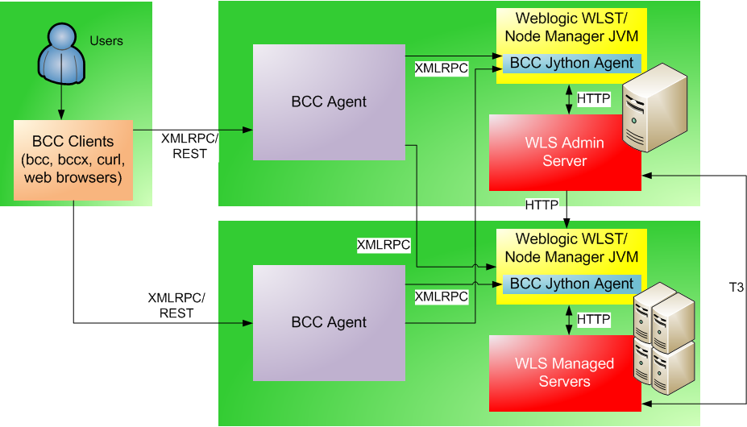
Communication Flow

Slide 7
Command Overview
bccnm
Node Manager Daemon Init Control (terminal)
Start, stop, restart WLS Node Manager
bccagent (+JVM agent)
BCC Agent Daemon Init Control (terminal)
Start, stop , restart BCCAgent
bcc
Banana Cluster Control Client (terminal)
Start, stop, check status WLS app servers
Other functions: encrypt/decrypt password, retrieve heap usage/health status/hogging thread number
bccx
Banana Cluster Control GUI Client (GUI-like via ncurses library)
Similar functionalities as bcc
Much easier to administer for beginners (can be used by non-UNIX admins)
Feature colour, gauges for a more intuitive design

Slide 8
Configuration Overview
Configuration files are located under the directory: bcc/config
bcc.ini
WLS and NM credentials; essential host & port info
Passwords can be hashed to increase security
bccagent.ini
bccagentd.ini
bccagentd.jy.ini
bccnm.ini
bccx.ini

Slide 9

bccnm & bccagent
Start, stop and restart Node Manager or BCC agent
For scripting mode, use -n or --nonblock
For verbose/debug mode, use -d
In non-interactive shell, colours are automatically removed (for scripting purpose)

Slide 10
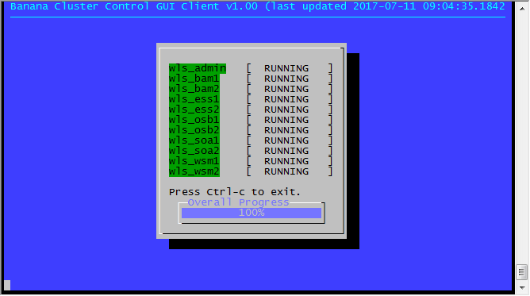
bcc & bccx
Start, stop and restart WLS apps
All calls are non-blocking (for scripting purpose)
Shell-type globbing is supported (e.g. bcc start "*2“)
Check status and health, hogging thread and heap usage
Status-type views via bccx are automatically refreshed

Slide 11
Questions?
Thanks for listening.

